Slide 1
Data Structures and Algorithms
LECTURE 06: SORTING

Slide 2
Objectives
Elementary Sorting Algorithms
Selection Sort
Insertion Sort
Bubble Sort
Efficient Sorting Algorithms
Shell sort
Quick Sort
Merge Sort
Heap sort
Radix Sort (*)
Sorting in java.util
Reading at home
Notes:
Note: (*) Means that students are required to understand essential features only (the problem explanation, definitions, the outline of algorithms…), not in details.

Slide 3
Elementary Sorting Algorithm

Slide 4
Selection sort

Slide 5
Selection sort
An attempt to localize the exchanges of array elements by finding a misplaced element first and putting it in its final place
Its complexity is O(n²)
selectionsort(data[])
for i=0 to data.length-2
select the smallest (or largest) element data[k] among data[i],…, data[data.length-1];
swap data[i] with data[k];

Slide 6
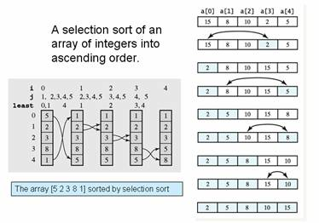
Selection example

Slide 7
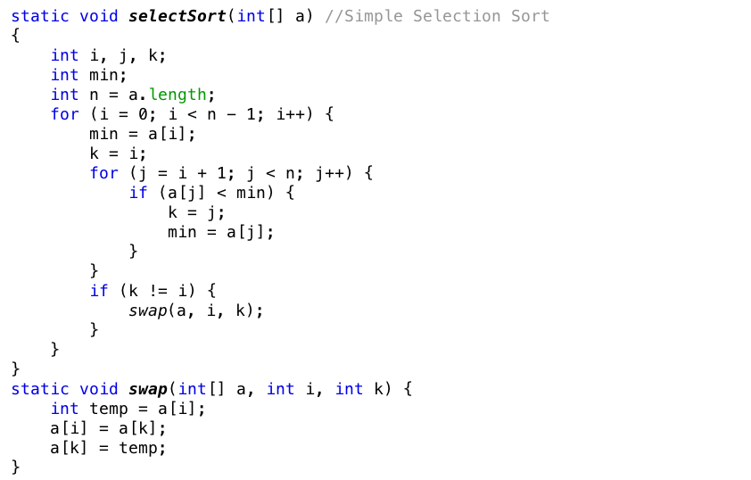
Selection sort implementation

Slide 8
Insertion sort algorithm

Slide 9
Insertion Sort
23
17
45
18
12
22

Slide 10
Insertion Sort
23
17
45
18
12
22
1
2
3
4
5
6

Slide 11
Insertion Sort
23
17
45
18
12
22
1
2
3
4
5
6
1
2
3
4
5
6

Slide 12
Insertion Sort
17
45
18
12
22
1
2
3
4
5
6
23
1
2
3
4
5
6

Slide 13
Insertion Sort
45
18
12
22
1
2
3
4
5
6
17
23
1
2
3
4
5
6

Slide 14
Insertion Sort
18
12
22
1
2
3
4
5
6
17
23
45
1
2
3
4
5
6

Slide 15
Insertion Sort
12
22
1
2
3
4
5
6
17
18
23
45
1
2
3
4
5
6

Slide 16
Insertion Sort
1
2
3
4
5
6
12
17
18
22
23
45
1
2
3
4
5
6

Slide 17
Insertion sort
An insertion sort starts by considering the two first elements of the array data, which are data[0] and data[1]
Next, the third element, data[2], is considered and inserted into its proper place (ascending)
Its complexity is O(n2) and best case is O(n)
insertionsort(data[])
for i=0 to data.length-1
tmp=data[i];
move all elements data[j] greater than tmp by one position;
place tmp in its proper position;

Slide 18
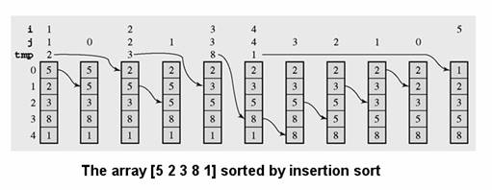
Insertion sort example

Slide 19
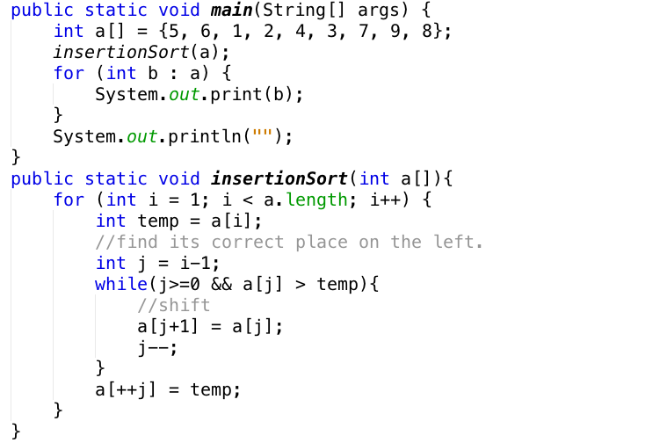
Insertion sort

Slide 20
Bubble Sort

Slide 21
Bubble Sort
Value present in each element is compared with subsequent elements to get the smallest/largest value
There are 2 approaches in bubble sort implementation:
Bottom-up
Top-down
Complexity O(n²); Best case O(n)

Slide 22
Bubble Sort
j=i+1=1
i=0
a[i]
a[j]
5
4
3
7
1
For an array of n elements
Repeat these following steps n-1 times:
With a[i] and a[j]:
If a[i] greater than a[j] then swap their location.

Slide 23
Bubble Sort
int i,j,temp,arr[5]={23,90,9,25,16};
for (int i=0; i<4; i++)
{
for (int j=i+1; j<5; j++)
{
if (arr[i] > arr[j])
{
int temp = arr[j];
arr[j] = arr[i];
arr[i] = temp;
}
}
}

Slide 24
Efficient Sorting Algorithms
Shell Sort, Quick Sort, Merge sort, Heap sort, Radix sort

Slide 25
Quick Sort

Slide 26
Quick sort
Efficient algorithm, discovered by C.A.R Hoare
Example of divide and conquer algorithm
Two phases
Partition phase
Divide the work into half
Sort phase
Conquer the halves

Slide 27


Partition & conquer
Choose a pivot
Find the position for the pivot so that
All elements to the left are less
All elements to the right are greater
Conquer
Apply the same algorithm to each halves

Slide 28
Quick sort complexity
In the best case and average case O(n log n)
Can be O(n2)
Depends on pivot selection
Median-of-3
Random pivot
Better but no guarantee

Slide 29
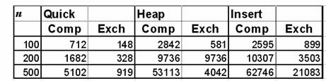
Quicksort – Why bother?
Use Heapsort instead?
Quicksort is generally faster
Fewer comparisons and exchanges
Some empirical data

Slide 30
How to partition
Define the pivot value as the contents of Table[First]
Initialize Up to First and Down to Last
Repeat
Increment Up until Up selects the first element > the pivot value
Decrement Down until it selects the first element <= the pivot value
If Up<Down exchange their values until Up meets or passes Down
Exchange Table[First] and Table[Down]
Define PivIndex as Down

Slide 31
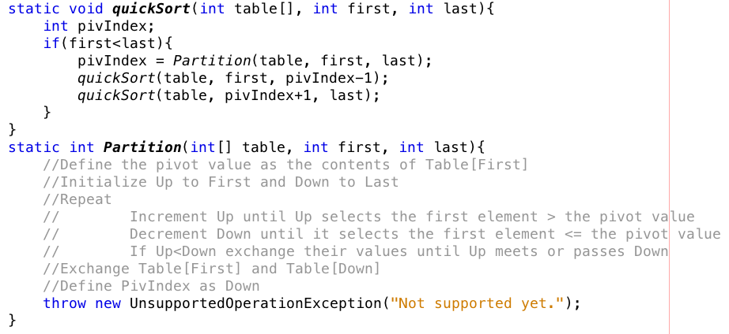
How do we partition

Slide 32
Mergesort

Slide 33
Mergesort
Mergesort makes partitioning as simple as possible and concentrates on merging sorted halves of an array into one sorted array
Complexity is O(nlogn)
It was one of the first sorting algorithms used on a computer and was developed by John von Neumann
mergesort(data)
if data have at least two elements
mergesort(lefthalf of data);
mergesort(righthalf of data);
merge(both halves into a sorted list);

Slide 34
Mergesort algorithm
mergesort(data)
if data have at least two elements
mergesort(lefthalf of data);
mergesort(righthalf of data);
merge(both halves into a sorted list);
merge (array1, array2, array3)
i1, i2, i3 are properly initialized;
while both array2 and array3 contain elements;
if array2[i2]<array3[i3]
array1[i1++]=array2[i2++]
else
array1[i1++]=array2[i3++]
load into array1 the remaining elements of either array2 or array3

Slide 35
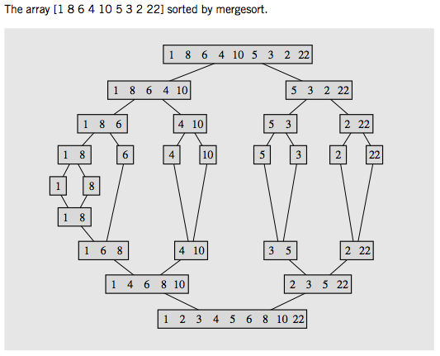
Mergesort example

Slide 36
Sorting in java.util

Slide 37
Sorting in java.util
Java provides two sets of versions for sorting methods: one for arrays and one for lists
The utility class Arrays includes method for
Search for elements with binary search
Filling arrays with a particular value
Converting array into a list
And sorting method
The sorting methods are provided for arrays with elements of all elementary types except boolean
For each type of sorting method there are two versions
One for sorting an entire array
public static void sort(int[] a)
One for sorting a subarray
public static void sort(int[] a, int first, int last)

Slide 38
The end

